Slide 1

Environmental Sound Classification Using a Residual Network Architecture
Arindam Dey
Master’s program in Data Science - Liverpool John Moores University and upGrad

Slide 2
Introduction
Background
Problem Statement

Slide 3
Background
In late nineties, audio data was mainly characterized by name, file-format, sampling rate etc.
Audio application were primarily limited to archiving, storing and separation of audio sources based on very basic characteristics.
As many parallel technologies evolved, newer use cases of environmental awareness started emerging.
Among them , there were use cases that required mimicking human perception based on sight and sound involving object-detection and source classification.
Machine Learning techniques applied to audio sound classification ( ASC ) were limited to KNN, SVM, GMM.
Instances of deep learning techniques started appearing in 2009 with limited datasets. Only from 2014, labelled datasets like ESC-10 and ESC-50 were available for benchmarking different models.
Sequential Deep Learning Models based on ESC dataset started appearing in 2015 .

Slide 4
Problem statement
Since 2015 most of the research on Deep Learning based ASC Task were on centered around Sequential CNN Architectures.
These models use backpropagation algorithm , that incrementally update the model weights so that the model can ‘learn’.
The algorithm suffers from the problem of vanishing gradients , as the depth of the model increases.
This is because , as the updates are propagated back to the beginning of a model, they become smaller and smaller with the depth.
Can building incrementally deeper CNN Architectures and combating Vanishing Gradients by using skip/residual connections lead to better accuracies for audio classification problems ? This leads us to a ResNet Architecture.
Whether MFCC features alone can lead us to >76% accuracies on the ESC-10 Dataset?

Slide 5
Literature review
Early Work on ASC
Evolution of CNN Architectures
Residual Connections
Audio Datasets ESC and Urbansound8K
CNN for Audio Classification

Slide 6
Early work on ASC
Before the ESC task , most audio classification was related to Speech/Non-Speech, Music/Movie Genre Classification or musical instrument classification.
Wold et al (1996) , built a Euclidean Distance Based Classifier based on loudness, pitch, brightness and bandwidth. It’s purpose was to fetch audio from a database based on acoustical and perceptual features.
Saunders (1996) reported Zero Crossing Rate (ZCR)Based Speech/Music discrimination as both have distinctly different ZCR characteristics.
More complex discriminator was built by Scheirer (1997) based on a 13 feature representation and using them on GMM, k-NN and k-d classifiers. They found music was harder to classify than speech.
Pierangelo (2002) used the findings of Saunders to build a ZB (ZCR Bayesian Classifier) based Speech/Music discriminator. When they compared it with a Neural Network, it outperformed the former by 11% in terms of Total Error Rate.
There were multiple such efforts based on different datasets , making it difficult to benchmark them against each other.

Slide 7
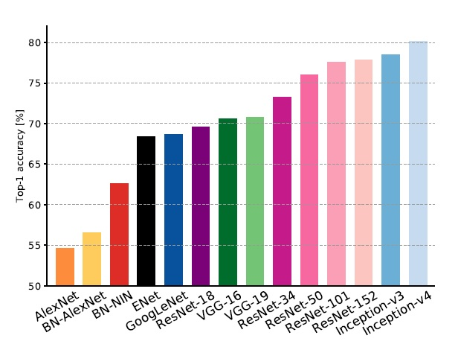
EVOLUTION of cnn architectures
Unlike auditory problems, deep learning architectures had access to a large repository of labelled imagery datasets.
As CNN architectures grew deeper and complex , they could be compared against each other , because they were all benchmarked in ILSVRC Challenge.
Earlier models were based on convolutional layers stacked one after another.
Szedgedy (2015) made the first departure from a linear architecture by introducing inception blocks in GoogLeNet.
He et al (2016) introduced the concept of residual connection in their architecture called ResNet.
Then on, most of the deep learning architectures departed from the linear architecture.

Slide 8
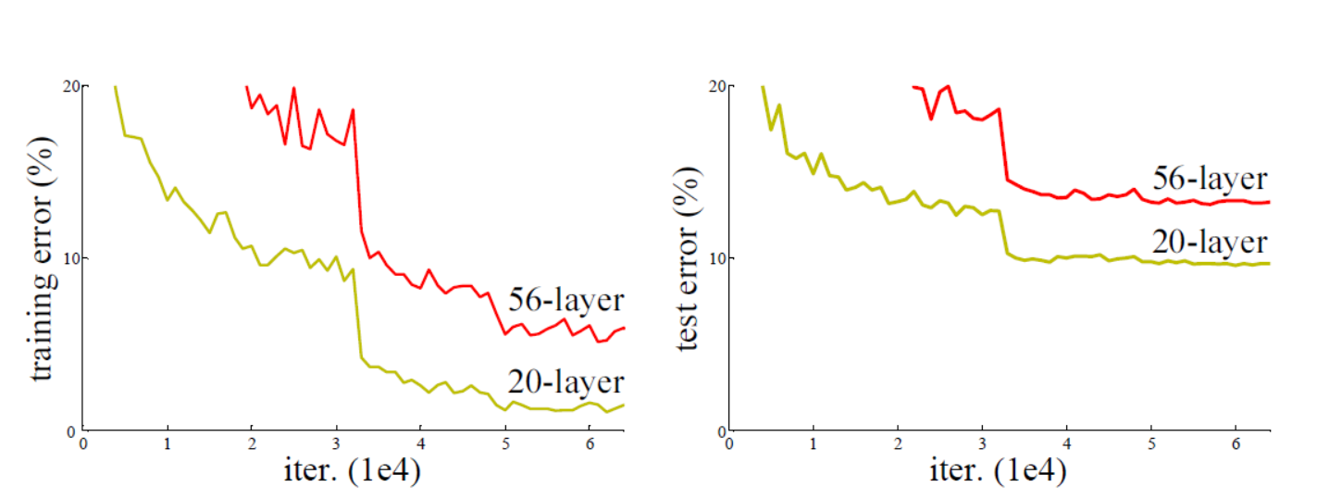
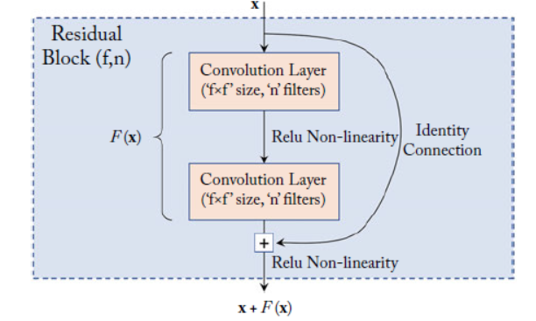
Residual connections
Though the winner of the ILSVRC in 2014 was the VGGNET architecture, the deep learning community realized that deeper models do not necessarily mean better performance.
This happens because of the vanishing-gradient problem , making it harder for weights in the earlier stages of a model to update themselves.
As He et al pointed out in their seminal paper 2016, the following illustration (left) shows how a 56 layers struggles to achieve the same error rate as a 20-layer model.
They introduced Residual Blocks (right) , which could combat vanishing gradient, thereby allowing much deeper models.

Slide 9
AUDIO DATASETS
Piczak et al (2015) noticed that , research on environmental sound classification has been limited due to absence of labelled dataset. This is unlike research on Computer Vision, where there multiple datasets like MNIST, CIFAR and Imagenet.
The use of the Freesound Project was demonstrated as potential research resource by Font et al in 2013.
The Freesound Project has a large repository of user uploaded audio samples since 2005.
Piczak used the Freesound API to build the ESC-10 and ESC-50 Datasets. Salamon presented an even bigger dataset called Urbansound8K in 2018
ESC-10
400 Samples of 10 Classes divided into 5 folds.
Each Class had 40 audio samples
Each Fold having 8 audio samples
ESC-50
2000 Samples of 50 Classes divided into 5 folds.
Each Class had 40 audio samples
Each Fold having 8 audio samples
Urbasound8K
400 Samples of 10 Classes divided into 5 folds.
Each Class had 40 audio samples
Each Fold having 8 audio samples

Slide 10
CNN for AUDIO CLASSIFICATION
Prior to 2009, Deep Learning hadn’t been used for Auditory problems as reported by Honglak et al.
They built a CDBN architecture for Speaker , Gender or Phone Classification , but still this wasn’t based on ESC dataset.
We notice CNN architectures applied to ESC datasets from 2015 by Piczak, Tokuzume and Khamaparia in successive years.
We will use the following as our references and explore the performance of our models with residual connections compared to them.
 | ESC-10 | ESC-50 | Urban 8K | Custom Dataset
Piczak , 2015 | 85% | 77% | 65% | -
Tokuzume, 2017 | 74.10% | - | - | -
Kaustumbh, 2018 | - | - | - | 85%
Sang, 2018 | - | - | 79% | -
Khamparia, 2019 | 77% | 49% | - | -

Slide 11
Research methodology
Pre-processing and Visualization
Cleaning
Feature Extraction 1 & 2
Dataset for Modelling

Slide 12
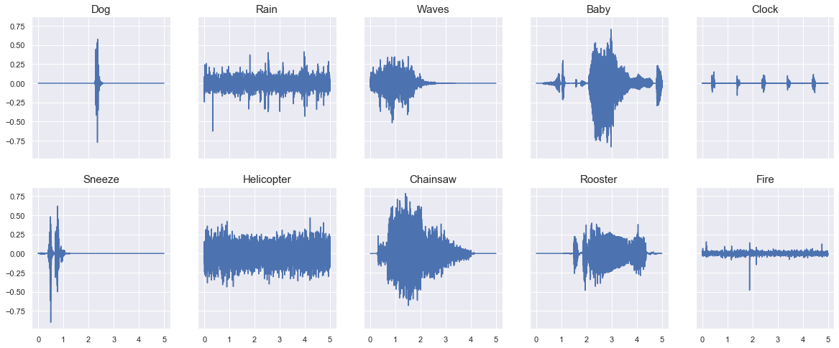
Pre-processing and visualization
The ESC-10 Dataset has 400 files with 10 classes. We show here one sample from each class sampled at 44100samples/second.
We divide the 400 files into 320 and 80 for respectively our training and validation sets.
Some samples are dominated by silent periods.
We clean the silent periods from each file and re-write them onto the disk

Slide 13
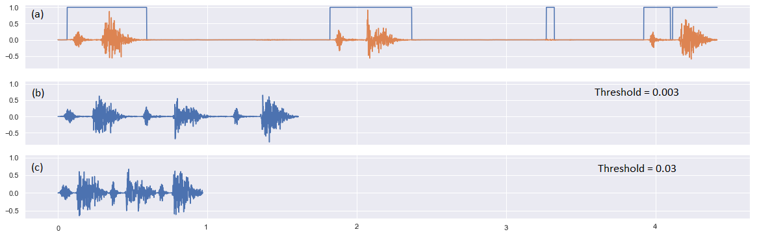
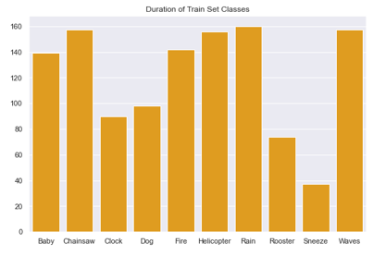
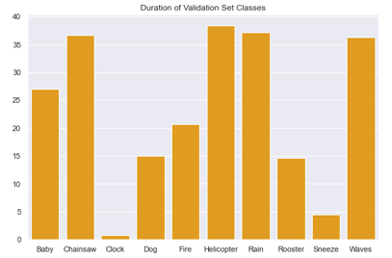
cleaning
We eliminate the silent portions of an audio file by taking a rolling average over 100ms.
We eliminate the portions , wherever the average is less than 0.003 for training and 0.03 for validation set.
The cleaned files are re-written onto the disk at a rate of 16000 samples/second.
Note, how we are left with very limited duration of audio for few classes ( clock and sneeze ) in the validation set

Slide 14
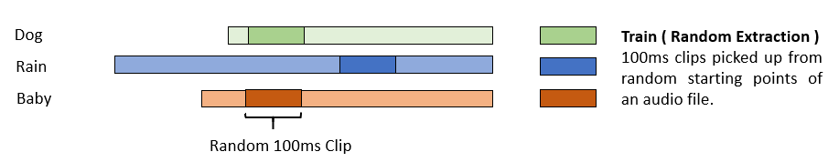
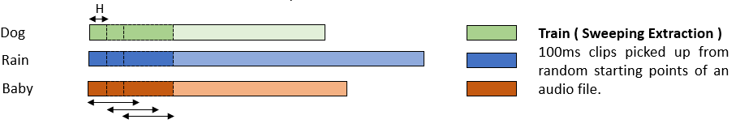
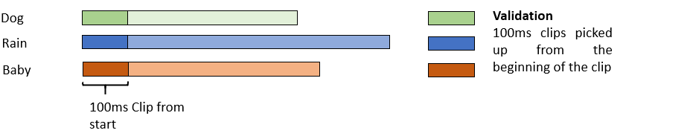
Feature extraction 1/2
For building the training set, we extract 100ms clips (1600 samples ) at random from anywhere within the audio file. We call this random extraction
For sweeping extraction , we use a gradually moving window with hop length H
For validation set however, we always extract the first 100ms as a clip.
This process leaves us with a large number of 100ms clips, that we’ll use to build our training data.

Slide 15
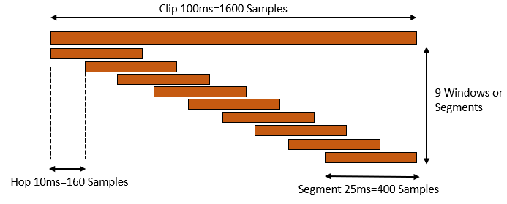
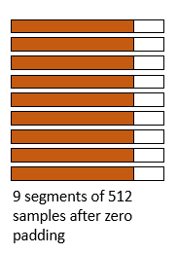

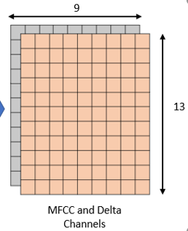
Feature extraction 2/2
Make overlapping segments of 25ms (M = 400samples), using a moving window of step size 10ms (L=160Samples).
This produces 9 segments of 25ms (400 samples) each, which we zero-pad to make the length 512 to calculate FFT.
The corresponding power spectra is given as |Xi (k)|².
Each of the 9 power spectra is filtered through a mel-filter bank followed by a discreet cosine transform to generate the MFCC and Delta Features

Slide 16
Dataset for modelling
 | Training Set Size | Validation Set Size
ESC_10 One Channel Input Random Extraction | 24200 x 13 x 9 | 71 x 13 x 9
ESC_10 Two Channel Input Random Extraction | 24200 x 13 x 9 x 2 | 71 x 13 x 9 x 2
ESC_10 One Channel Input Sweeping Extraction | 92274 x 13 x 9 | 71 x 13 x 9
Usound_1000 Sweeping Extraction | 263633 x 13 x 9 x 1 | 554 x 13 x 9 x 1
Usound_800 Sweeping Extraction | 327185 x 13 x 9 x 1 | 554 x 13 x 9 x 1
The feature extraction highlighted earlier gives us these datasets that were used to train models.
For the Urbansound8K dataset, we used the sweeping extraction method exclusively
During training, we built a generator function to extract random batches from these arrays.

Slide 17
modelling
Baseline Models
Deeper Models
Introducing Skip Connections
Implementing ResNet50

Slide 18
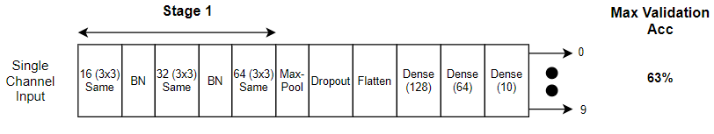
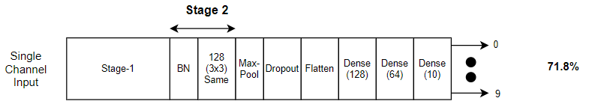
BASELINE MODELs
We built a shallow model with 11 stages and it could reach a maximum validation accuracy of 63%
When we introduce two additional layers , we reach a validation accuracy of 71.8%.
Does this mean, adding more layers can generate better accuracies ?

Slide 19
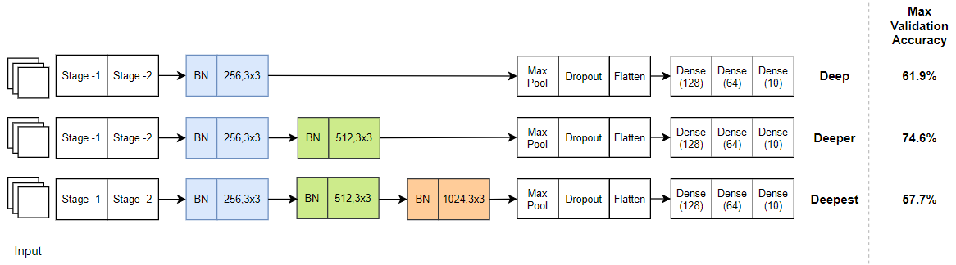
DEEPER MODELS
As we increase the depth of the models, we notice that the Deep and Deepest models struggle to keep up with our baseline performance.
At this point, if we introduce skip connection in the Deep and Deepest models, can we recover the lost accuracy ?

Slide 20
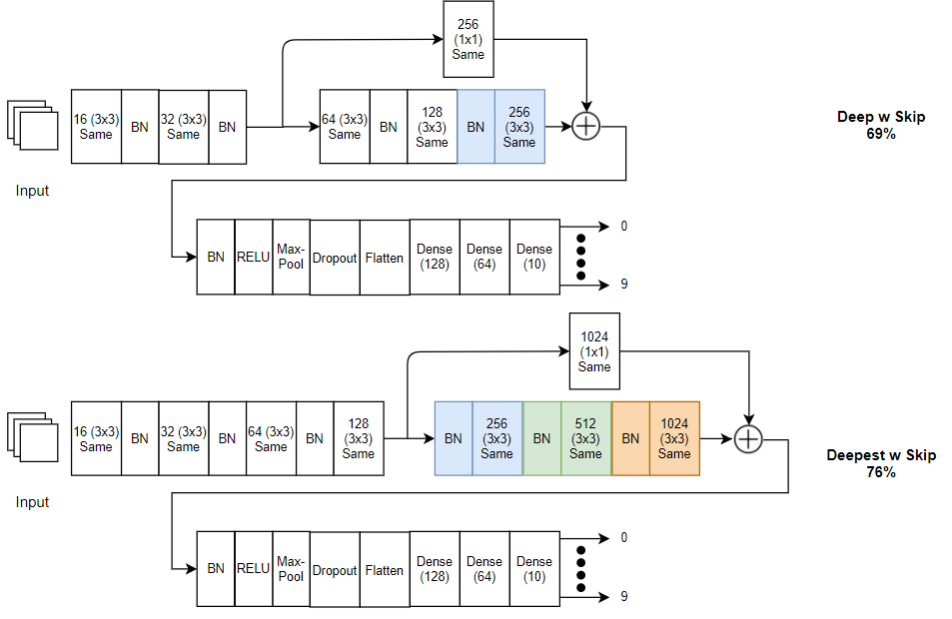
Introducing skip connections
The choice of the position of the residual connection is very important.
These configurations lead to accuracies that are close to or better than the baseline models.

Slide 21
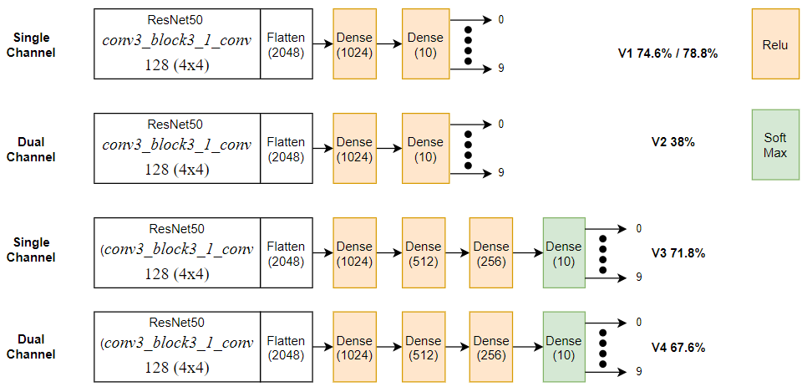
Implementing resnet architecture
We used a section of the ResNet50 architecture to see how they perform.
We only use the first 62 layers of the ResNet50 model and follow it with custom flattening layers.
The dual channel input causes performance to degrade.
The single channel input performance are very close to or better than the baseline model.
Finally , when we try the V1 variant with sweeping extraction input, we are able to exceed 76% (our problem statement)

Slide 22
results
Final Results
Further Studies

Slide 23
Final results
Architecture | ESC -10 Dataset (Single/Dual Channel Input) | Max Validation Accuracy | Train Accuracy at Max Val | Number of Stages | Reference
Shallow Model | Random Single | 63.0% | 61.2% | 11 | Piczak - 85% Tokuzume -74.10% Khamparia - 77%
Best Baseline Single |  | 71.8% | 73.5% | 13
Best Baseline Multi | Random Dual | 66.2% | 75.5% | 13
Deep | Random Single | 61.9% | 58.0% | 15
Deep w Skip |  | 69.0% | 71.5% | 15
Deeper |  | 74.6% | 77.7% | 17
Deepest |  | 57.7% | 73.9% | 19
Deepest w Skip |  | 76.0% | 79.9% | 19
Resnet V1 | Random Single | 74.6% | 99.4% | 62
Resnet V1 Sweep | Sweep Single | 78.8% | 99.4% | 62
Resnet V2 Multi | Random Dual | 38.0% | 34.3% | 62
Resnet V3 | Random Single | 71.8% | 96.0% | 62
Resnet V4 Multi | Random Dual | 67.6% | 97.9% | 62

Slide 24
Further studies
The impact of residual connection on classification provides motivation for training the variants of Resnet architecture proposed by He et al.
We were able to reach 78.8% validation accuracy based on the MFCC features alone. Adding a second or third channel with feature selection techniques can provide potentially better results.
The performance of some of the classes like Clock and Sneeze, warrant more samples from Freesound to get better results.
The performance of a reduced version of the Resnet50 also paves the way of other alternatives like ResNext or Inception.
We did not use any data augmentation techniques in particular. This can be explored with the full ResNet or Inception architectures to get even better results.

Slide 25
Thank you

